Slide 1
An introduction to
Theory of Change
Ruth Kaufman OBE, FORS, FIMA
President, The OR Society
16 May 2016

Slide 2
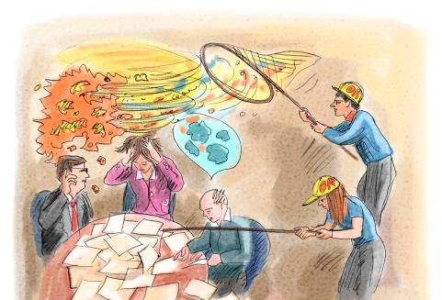
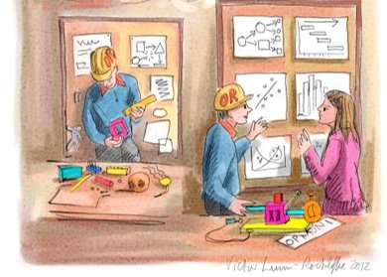
How does OR help the third sector?
Faced with the tangled mess of problem situations…
…finding a way of making sense and seeing possible solutions

Slide 3
Theory of Change – an introduction
Activities what the charity does
Outputs what the activities provide
Outcomes the changes the charity wants to happen
The ultimate goal the charity is trying to achieve
enablers
evidence/
assumptions

Slide 4
Theory of Change substitutes for business plan
Private sector
vision
investment
Investors
If business model or delivery is no good,
income stops.
return
product
customer
payment
Charity
vision
investment
Donors
If business model or delivery is no good, donations may continue.
vision
product
beneficiaries

Slide 5
Why don’t charities have one to start with?
Started with the activity​
​
Strong vision​
  No evidence​
  Gradual developments over time​
  ​
Don’t need one! – just need to be financially sustainable​
Started with the activity
Strong vision
  No evidence
  Gradual developments over time
Don’t need one! – just need to be financially sustainable

Slide 6
How framework can be used
Provide narrative for organisation
Basis for getting shared vision
Basis for strategy:
  Developing
  Prioritising
  Checking assumptions
Basis for evaluation
Identify activity gaps, possible collaboration

Slide 7
Is like any model
Identify structure participatively with system owners
Simple ⬅===================➔complex
Picture, spreadsheet, DES, system dynamics …
Use the structure: support discussion, gain insight
Populate: forecasts, analysis, evaluation

Slide 8



Common experience of charities…
Activities what the charity does
Outputs what the activities provide
Outcomes the changes the charity wants to happen
The ultimate goal the charity is trying to achieve
enablers
evidence/
assumptions

Slide 9
Supporting discussions with Theory of Change
Charity in dire financial position, needing to make major adjustments
Charity in poor financial position, needing to prioritise
Charity in good financial position, needing to review strategy in light of opportunities, threats, risks
Charity needing to make case to its funders

Slide 10
Some questions to help home in
What key points describe the world you want to see, or the difference you want to make?
What key things do you do that make you you and not some other organisation?
What are the tangible changes that you want to make/ outcome you wish to see:
  ones without which you might as well not exist (because they are an integral part of the vision)?
  ones that are important in a business sense?

Slide 11
Set the thinking going
SWOT discussion: reality check
Facilitated discussion:
agree the dream
Activities what the charity does
Outputs what the activities provide
Outcomes the changes the charity wants to happen
The ultimate goal the charity is trying to achieve
enablers
evidence/
assumptions

Slide 12
Don’t do more than is necessary
The completion of this theory is left as an exercise for the reader

Slide 13








Pro Bono OR
Volunteers

Slide 14
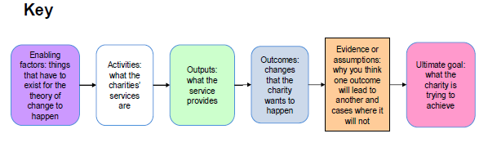
Theory of Change for Pro Bono OR
Better strategy
ORS
activities
Volunteer
activities
Clarity about issues + possible next steps
Better evidence base
Better buy-in
Better design and choosing of options
Better preparation for consequences
Initial telephone consultation
Data collection, analysis, presentation
Data/analysis: past, present or forecast:
The environment
Service operations
Service outcomes
Stakeholders inc beneficiaries
Risk
Finance
Models for:
Scenario analysis
Operational improvement
Policy analysis
Prioritisation
Insight
Group involvement in information provision and decision-making
Better operations
More efficient
More effective
Charities are more efficient and effective in meeting their objects
Model design, build and use
Initial project specification
Robust understanding of factors relevant to decision-making
Better targeted
Better governance
Systems, processes:
Data collection, monitoring
Management info
Operations
Strategic planning
Evaluation f/wk
….
Workshop design and facilitation
Workshops for:
Knowledge share
Exploring issues
Identifying options
Decision-making
Better risk mgmt
More detailed project terms of reference, undertaking and delivery
Capability for designing efficient and effective operations
Project/ programme plans
Better funding
Improved systems and processes
More income
More sustainable income
Access to ORS SIG meeting and mailings
System/ process design/build
More predictable income

Slide 15
Beneficiary perspective:output-outcome-change
Data analysed, presented
Models built and applied
Workshops held
Systems/processes built and implemented
Charities have better strategy
Charities are more efficient and effective in meeting their objects
Charities have better operations
Charities have better funding

Slide 16
OR Society perspective
Analysts register as volunteers
Analysts complete useful projects
OR publicity and marketing material is shared
Analysts experience is shared
Analysts engage with OR Society
The OR Society is more effective
Analysts learn and teach
O.R. is more visible and influental
3rd sector aware of OR and its power

Slide 17
And for volunteers…
Charity more successful
Values
Evidence
The world is better
Completed project
Undertake
Pro Bono OR
Project
More awareness of OR
Satisfied client
I am better
Personal:
Experience + knowledge
Personal:
satisfaction

Slide 18
Summary
Theory
Of
Change
Simple way to structure thinking
Standard in charity world
Good fit with OR approach
I commend it to you!

Slide 19
Where to find out more
www.theoryofchange.org
www.thinknpc.org/about-npc/expertise/theory-of-change/

